Slide 1
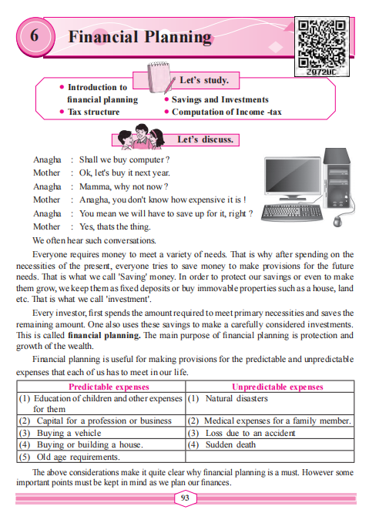





crystal concept
Financial Planning
Std 9th Maharshta Board
Saving
Investment

Slide 2
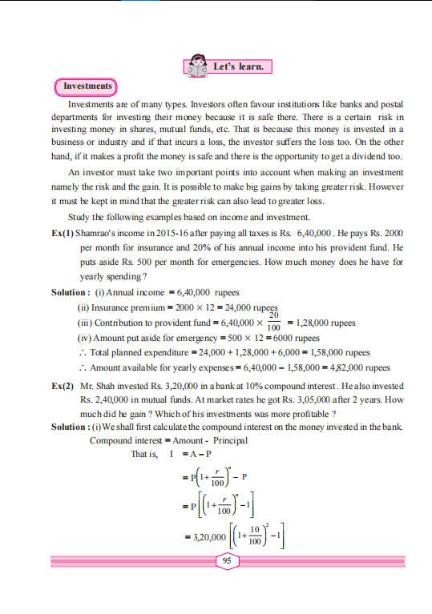
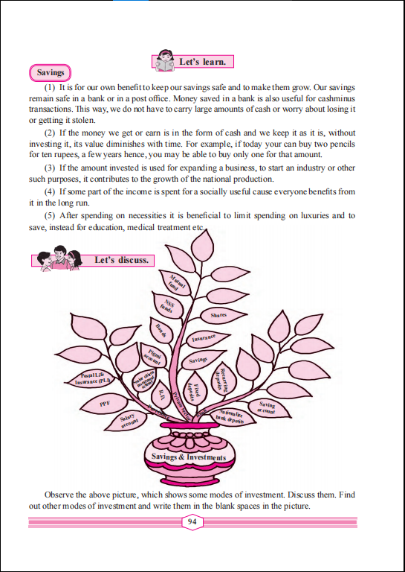
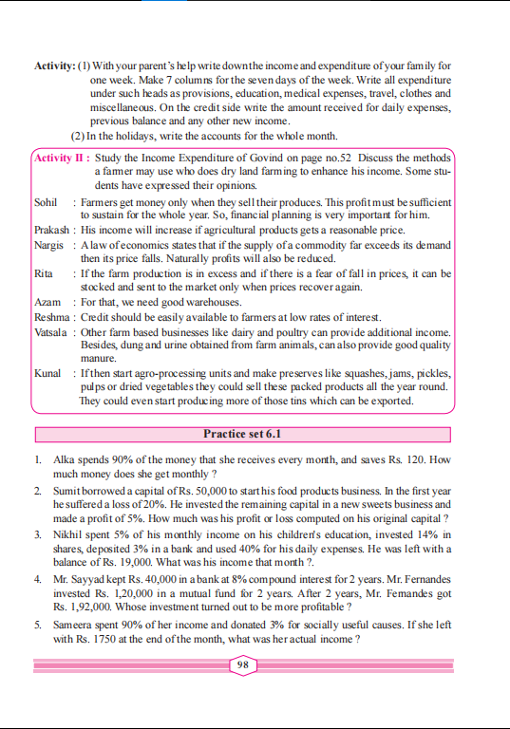
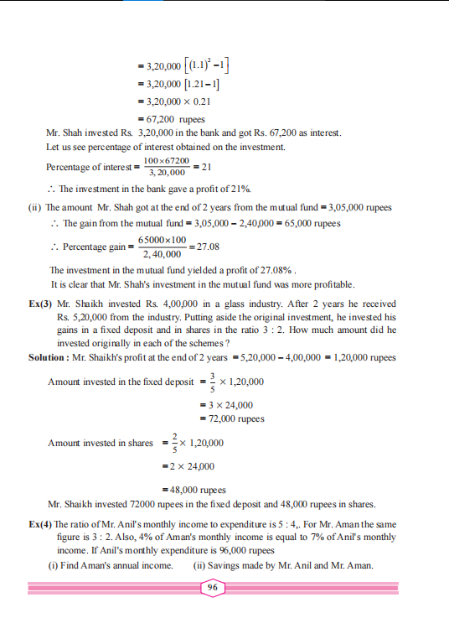

crystal concept

Slide 3
crystal concept
fixed deposits or buy immovable properties such as a house, land etc.
That is what we call 'investment'.

Slide 4

crystal concept
One also uses these savings to make a carefully considered investments.
This is called financial planning

Slide 5

crystal concept
Predictable expenses
(1) Education of children and other expenses for them

Slide 6

crystal concept
(2) Capital for a profession or business

Slide 7

crystal concept
(3) Buying a vehicle

Slide 8

crystal concept
(4) Buying or building a house.

Slide 9

crystal concept
(5) Old age requirements

Slide 10
crystal concept
UnPredictable expenses

Slide 11

crystal concept
(1) Natural disasters

Slide 12

crystal concept
(2) Medical expenses for a family member.

Slide 13

crystal concept
(3) Loss due to an accident

Slide 14

crystal concept
(4) Sudden death

Slide 15

crystal concept
Financial Planning

Slide 16




Slide 17


Investments
crystal concept
Safe
Risk
banks
+
Postal department
shares
+
mutual funds

Slide 18



crystal concept
It is possible to make big gains by taking greater risk.
However
it must be kept in mind that the greater risk can also l
ead to greater loss.

Slide 19

crystal concept
Kuch Basic Ho Jaaye
500 , 5 loss
100 , 1 loss
1 % 0f 500 =
5 % 0f 500 =

Slide 20
crystal concept
Ex(1) Shamrao's income in 2015-16 after paying all taxes is Rs. 6,40,000 . He pays Rs. 2000
per month for insurance and 20% of his annual income into his provident fund. He
puts aside Rs. 500 per month for emergencies. How much money does he have for
yearly spending ?

Slide 21
crystal concept
Simple Interest
Compound Interest

Slide 22
crystal concept
Ex(2) Mr. Shah invested Rs. 3,20,000 in a bank at 10% compound interest . He also invested
Rs. 2,40,000 in mutual funds. At market rates he got Rs. 3,05,000 after 2 years. How
much did he gain ? Which of his investments was more profitable ?

